Slide 1


Adidas Power BI Project
-Created by Shweta Kapile
-Guide by Ashutosh Sir

Slide 2

Introduction to the Data
Our dataset includes key metrics such as sales, profit, and product performance across various regions and retailers.

Slide 3
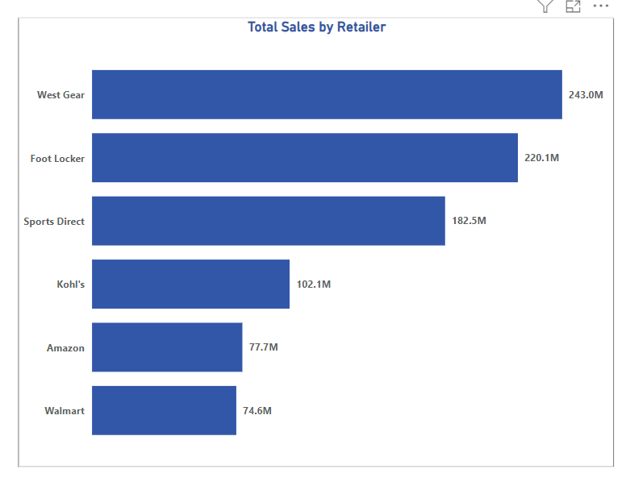
Retailer Analysis
Top Performing Retailers
Identify the most successful retailers driving Adidas' sales, highlighting best practices and growth opportunities.

Slide 4
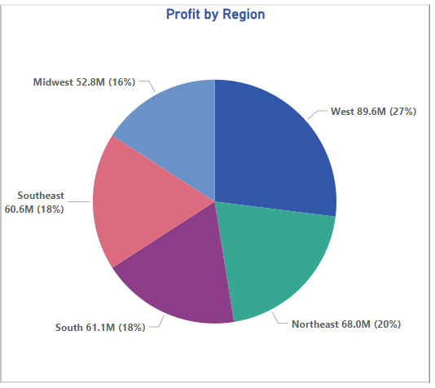
Regional Performance
West – 27% Profit
Northeast -20% Profit
South -18% Profit
Southeast -18% Profit
Midwest-16% Profit

Slide 5
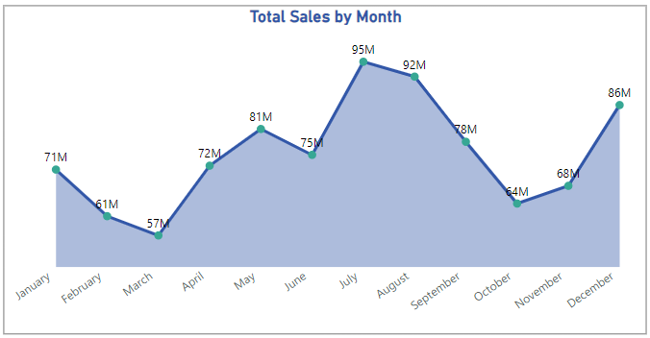
Total sales by Months

Slide 6
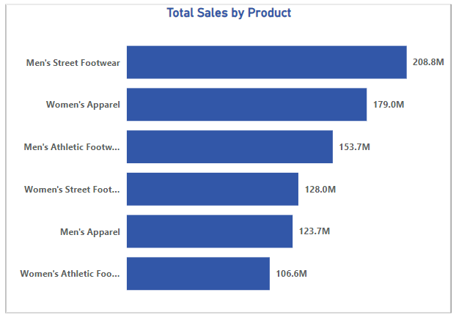
Product Insights
High Sales of Product
Men’s Street Footwear
Women’s Apparel
Men’s Athletic Footwear
Women’s Street Footwear
Men’s Apparel
Women’s athletic Footwear

Slide 7
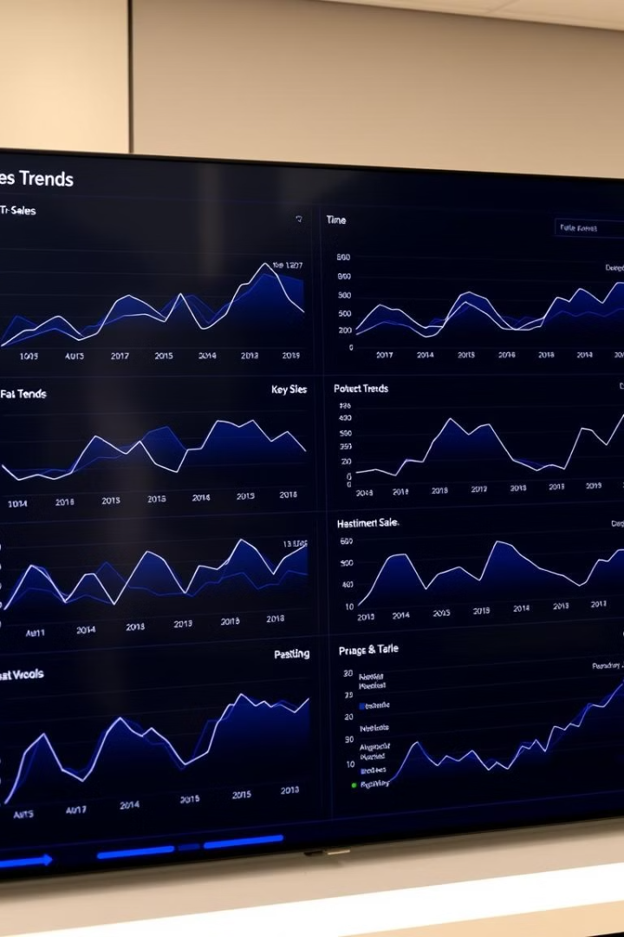
Adidas Overall Sales Analysis
Total Sales- $899.9M
Total Profit- $332.1M
Total Unit Sold- 2.5M
Average Price Per Unit-$45.2
Average Margin- 42.3%

Slide 8

Conclusion
Leveraging these insights will help Adidas maintain its position as a leading global sportswear brand.

Slide 9
Thank You

